Slide 1
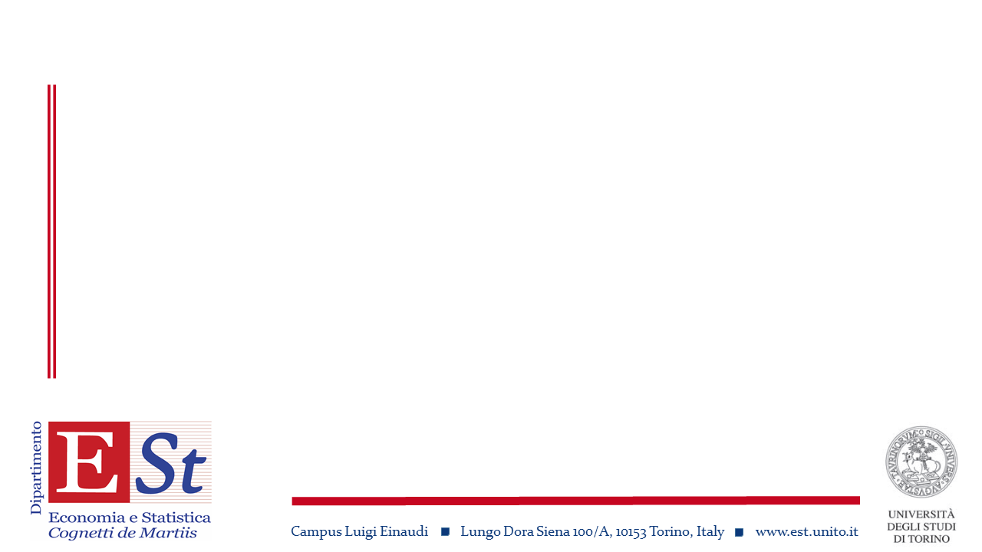
Popolazioni, migrazioni, sviluppo
Chiara Pronzato
University of Turin, academic year 2021-22

Slide 2

What we are going to talk about
Three parts
A historical introduction
Population structure, mortality, fertility, migrations
  Comparisons across regions and over time
Current topics in population and development
Chiara Pronzato

Slide 3
Syllabus
The program will cover the following topics
Introduction
2) Word demographic patterns
3) Mortality patterns, mortality differentials, mortality decline, and mortality issues in in more/less developed regions
4) Fertility patterns, and fertility decline in more/less developed regions
5) Age and sex structure and population projections
6) Migration and urbanization
7) Use of demographic tools (life tables, fertility and reproduction rates, age-structure indexes, projections)
Chiara Pronzato

Slide 4
Syllabus (cont.)
8) Determinants and consequences of fertility and nuptiality behaviors in high / low income regions
9) Determinants and consequences of health and longevity in the high-income regions of the world
10) Determinants and consequences of migration in high / low income regions
11) Students’ presentations on chosen topics
Chiara Pronzato

Slide 5
Material
Material on the web
  Slide (“theory”)
  Lezioni (tables & graphs)
  Articoli (papers)
    Password: PMS
Books / articles
  MASSIMO LIVI BACCI, Storia minima della popolazione del mondo, Il Mulino, 2016
  BARBARA ANDERSON, World Population Dynamics: An Introduction to Demography, Pearson, 2014
  Articles from Demography & Population and Development Review
Chiara Pronzato

Slide 6
Lectures
Thursday and Friday 9.15-11-45
From September 24th (18 lectures)
In classroom E2
https://unito.webex.com/unito/j.php?MTID=me92d839f6afe7507f7eaf87de35e41cc
Chiara Pronzato

Slide 7
Exam
The exam will include 4 questions:
An exercise on the calculation of life expectancy, and / or fertility and reproduction rates, and / or of population structure indexes, and / or of the expected population [topic 7 in "Program"]
One question on the figures and / or tables describing the demographic trends at the macro level [topics 2-6 in "Program"]
Two questions on the figures and / or tables of research on demographic behavior [topics 8-10 in "Program"]
Chiara Pronzato

Slide 8
Exam (cont.)
Attending and “active” students (in the first 6-8 lectures) can skip question 2 since they will work during the lessons on these topics
Students who present the paper can ship either question 3 or question 4
Written exam (in presence), oral exam (Webex)
During the lessons, students will have the opportunity, through different stimuli, to summarize and reflect on the material presented, in order to make them active in learning and aware of the knowledge acquired
Chiara Pronzato

Slide 9
Lecturer
Chiara Pronzato
  Office hours
  https://www.didattica-est.unito.it/do/docenti.pl/Show?_id=cpronzat#tab-ricevimento
  CV
  https://www.didattica-est.unito.it/do/docenti.pl/ShowFile?_id=cpronzat;field=cv;key=voMWt2sIE3MSYhhNvp5CI;t=2077
  Research papers
    https://ideas.repec.org/e/ppr62.html
Chiara Pronzato

